Slide 1

Session 3: Markov Decision Processes & Dynamic Programming
Dr. Sangeetha Viswanathan
Assistant Professor, CSIS
BITS Pilani WILP

Slide 2
Session Overview
1
What is MDP? Formal definition, Markov Property
2
MDP & RL Problem Agent-environment loop
3
MDP Formulation (S, A, P, R, γ) tuple
4
Returns & Rewards Episodic vs. continuing
5
Value Functions V(s), Q(s,a), returns
6
Bellman Equations Expectation & optimality
7
Dynamic Programming Policy eval & improvement
8
Value Iteration Full algorithm walkthrough
9
GPI Policy eval + improvement loop

Slide 3
What is a Markov Decision Process (MDP)?
Definition
Why MDPs?
An MDP is a mathematical framework for sequential decision-making under uncertainty.
Formalises the agent-environment interaction
Backbone of almost all RL algorithms.
Enables rigorous optimality, value, and policy definitions.
Applies to robotics, games, scheduling, finance.
Markov Property
P(S₁ | S₀, A₀) = P(S₁ | S₀, A₀, ..., full history)
The current state captures all relevant history — no need to remember the full trajectory.

Slide 4
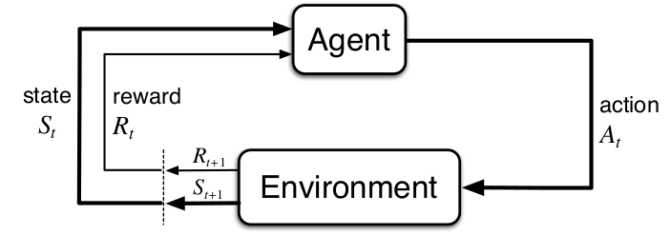

How Does MDP Relate to the RL Problem?
MDP as the RL Formalism
RL assumes the environment IS an MDP (or close to one).
Agent does NOT know dynamics p(s’,r|s,a) — learns from interaction.
DP (this session) assumes FULL model knowledge — a planning setting.
Model-free RL (TD, Q-learning) removes the model requirement.
Note:
Interaction occurs in discrete time steps
Key Insight
The agent-environment boundary is NOT physical — it is where the agent loses control.
Rewards always come FROM the environment; the agent cannot modify the reward signal.
Everything inside the agent (policy, value estimates) is under agent control.

Slide 5
MDP Formulation
Formal Tuple: (S, A, P, R, γ)
Dynamics Function (S&B §3.2)
Set of all states (state space)
p(s’, r | s, a) = Pr{Sₜ₊₁=s’, Rₜ₊₁=r | Sₜ=s, Aₜ=a}
Completely characterises environment dynamics.
From p we derive: transition probs, expected rewards, and state-action values.
S
A
Set of all actions (action space)
P(s’|s,a)
Transition probability function
R(s,a,s’)
Expected reward for transition (s,a)→s’
Policy π
Discount factor — weights future reward
π(a | s) = Pr{Aₜ = a | Sₜ = s}
Stochastic: probability distribution over actions given state.
Deterministic: π(s) = a (special case)
Goal: find the optimal policy π* that maximises expected return.
γ ∈ [0,1]

Slide 6
Returns and Rewards
“All of what we mean by goals and purposes can be well thought of as the maximisation of the expected value of the cumulative sum of a received scalar signal.” — Reward Hypothesis (S&B 3.2)
Reward Signal Rₜ
Return Gₜ
Recursive Relationship
Scalar feedback at each time step.
Rₜ ∈ ℝ — can be positive or negative.
Goal: maximise E[Σ Rₜ] not just immediate reward.
Designed by the engineer — specifies WHAT to achieve, not HOW.
Episodic: Gₜ = Rₜ₊₁ + Rₜ₊₂ + … + Rₜ₊ₜ
Discounted: Gₜ = Σₖ₌₀ γᵏ Rₜ₊ₖ₊₁
γ = 0: myopic agent (only next reward).
γ → 1: far-sighted (all future equally weighted).
Gₜ = Rₜ₊₁ + γ Gₜ₊₁
This one equation is the seed of all Bellman equations.
Enables bootstrapping: estimate G from partial returns.
Foundation of Dynamic Programming & TD learning.

Slide 7
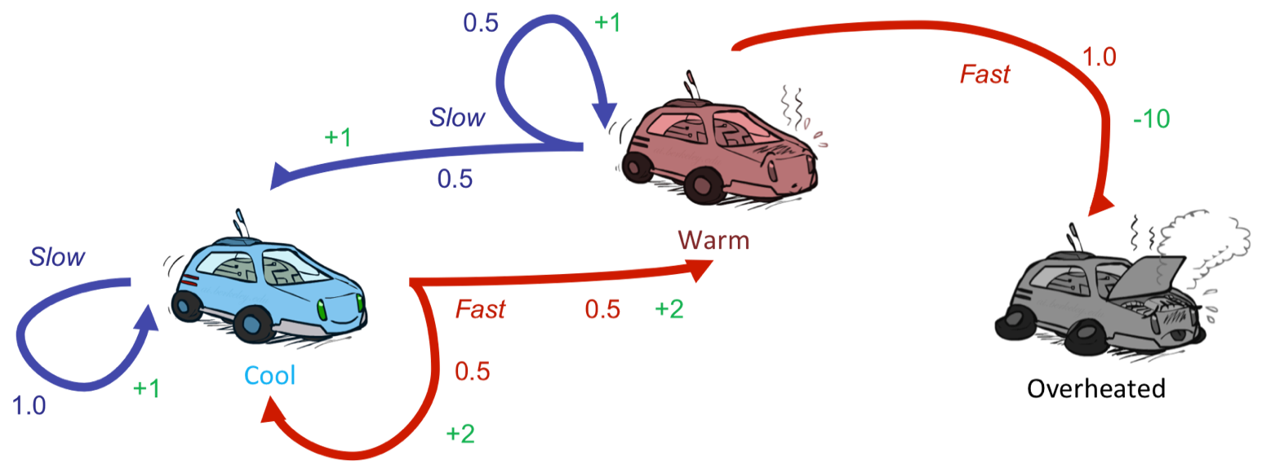
Problem Definition
Race Car Laps
A race car completes laps while managing engine temperature and speed decisions. Here each step is a segment of a lap in the track where the car learns to trades off lap time against overheating risk. The more the lap the car completes it performance betters. Car shuts down only when its engine get overheated (optional terminal state).
Key Characteristics:
The agent must act under uncertainty —
percepts are local, and the agent must reason about hidden dangers
Assume there is no fuel constraints or No.of.Laps to complete!
At every time step the next potential engine temperature
depends on the current engine state not the past history
Faculty Development Workshop on Deep Reinforcement Learning - 9 & 10 March,2026

Slide 8
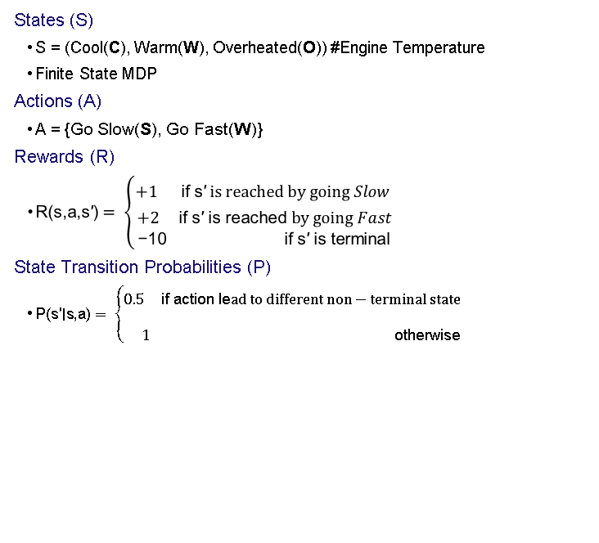
MARKOV DECISION PROCESS FORMALIZATION (Simplified)
1
2
(F) }
3
4
Faculty Development Workshop on Deep Reinforcement Learning - 9 & 10 March,2026

Slide 9
Value Functions — V(s) and Q(s,a)
State-Value Function Vᵄ(s)
Action-Value Function Qᵄ(s,a)
Vᵄ(s) = Eᵄ [ Gₜ | Sₜ = s ]
- Expected return starting in state s, following π thereafter.
Answers: “How good is it to BE in this state under π?”
Used in policy evaluation and improvement.
- Higher V(s) = better position to be in.
- V(s) = 0 for terminal states (game over).
- V(s) depends on BOTH the state AND the policy.
Qᵄ(s,a) = Eᵄ [ Gₜ | Sₜ = s, Aₜ = a ]
Expected return starting from s, taking action a, then following π.
Answers: “How good is it to TAKE this action in this state?”
Central to Q-learning and actor-critic methods.
Relationship & Optimality
Vᵄ(s) = Σₐ π(a|s) Qᵄ(s,a) [V as weighted avg of Q]
V*(s) = maxᵯ Vᵄ(s) for all s | Q*(s,a) = maxᵯ Qᵄ(s,a)
Optimal policy: π*(s) = argmaxₐ Q*(s,a) — deterministic & greedy w.r.t. Q*

Slide 10
Bellman Expectation Equation
Core Idea
Why is it Needed?
Decomposes the value of a state into:
Immediate reward + discounted value of next state.
Turns a hard optimisation into a recursive local computation.
Foundation of all DP and TD methods.
V _{π}(s) = [ immediate reward ] + γ × [ value of where we end up ]
Bellman equation is a consistency condition: V must satisfy it for every state.
Solving this system (|S| equations, |S| unknowns) gives Vᵄ exactly.
To compute V π(Cool), you need:
→ All paths from Cool under π
→ Their probabilities × total returns
→ Sum infinitely many trajectories
For even 3 states × 2 actions × infinite horizon = computationally intractable!
Bellman for Vᵄ(s):
Vᵄ(s) = Σₐ π(a|s) Σₛ’,ᵣ p(s’,r|s,a) [ r + γ Vᵄ(s’) ]
Bellman for Qᵄ(s,a):
Qᵄ(s,a) = Σₛ’,ᵣ p(s’,r|s,a) [ r + γ Σₐ’ π(a’|s’) Qᵄ(s’,a’) ]

Slide 11
Bellman Expectation Equation — Derivation
Step 1: Start with the definition of V π(s)
V π(s) = Eπ [ Gₜ | Sₜ = s ]
Step 2: Expand return Gₜ = Rₜ₊₁ + γGₜ₊₁
V π(s) = Eπ [ Rₜ₊₁ + γGₜ₊₁ | Sₜ = s ]
Step 3: Split expectation (linearity)
V π(s) = Eπ [Rₜ₊₁ | Sₜ = s] + γ · Eπ [Gₜ₊₁ | Sₜ = s]
Step 4: Marginalise over actions and next states
V π(s) = Σₐ π(a|s) Σₛ' P(s'|s,a) [ R(s,a,s') + γ · V π(s') ]

Slide 12
Bellman Optimality Equation
Optimal Policy π*
Why Optimality Equations Matter
A policy π* is optimal if Vπ*(s) ≥ Vπ(s) for ALL states s and ALL policies π.
For finite MDPs, at least one deterministic optimal policy always exists (S&B §3.6).
Optimal policies share the same V* and Q*.
These non-linear equations define the solution to the RL problem.
DP solves them via iteration; Q-learning approximates Q* from samples.
Once Q* is known, acting optimally is trivial: pick argmaxₐ Q*(s,a).
V*(s) = maxₐ Σₛ’,ᵣ p(s’,r|s,a) [ r + γ V*(s’) ]
Q*(s,a) = Σₛ’,ᵣ p(s’,r|s,a) [ r + γ maxₐ’ Q*(s’,a’) ]
π*(s) = argmaxₐ Q*(s,a) — greedy policy w.r.t. Q* | At optimality: V*(s) = Q*(s, π*(s))

Slide 13
Dynamic Programming — Overview
What is Dynamic Programming?
A collection of algorithms that use a FULL model of the MDP to compute optimal policies.
Key idea: use value functions to structure the search for optimal policies.
Requires: complete, accurate model p(s’,r|s,a). NOT applicable to model-free RL directly.
① Policy Evaluation (Prediction)
② Policy Improvement
Given policy π, compute Vᵄ(s) for all s ∈ S.
Apply Bellman expectation backup iteratively.
Converges to Vᵄ as sweeps → ∞.
Also called the “prediction problem”.
Given Vᵄ, derive a greedy policy π’ w.r.t. Vᵄ.
Policy Improvement Theorem: π’ is ≥ π.
If no improvement: Vᵄ = V*, π is optimal.
Also called the “control problem”.
DP Algorithms: Policy Iteration = repeated (Eval + Improve) | Value Iteration = combined in one sweep | Asynchronous DP = flexible update order

Slide 14
Dynamic Programming
Scenario
In a modified Race car, there is a training track where agent is given a known map and risk factors(dynamics) in advance. Agent knows exactly where it is and its action how actions result in engine state change (KNOWN MODEL).
With full knowledge, the agent can compute optimal policies by trying through all states.
(1)
Faculty Development Workshop on Deep Reinforcement Learning - 9 & 10 March,2026

Slide 15
Dynamic Programming
1
Given
P(s` | s, a) , R(s, a, s`) , P(s`, r | s, a)
2
To find
Policy π
3
Solution
Policy Iteration (PI): Prefer this in a relatively smaller state space where intermediate termination provides explicit interpretable policy
Value Iteration (VI): Prefer this in a relatively larger state space where fast convergence to optimal policy is obtained at the end
VI can be thought of truncated PI where evaluation is done fully before improvement.
4
Idea
PI : One Step Look ahead 🡪 Evaluate 🡪 Improve
VI : One Step Look ahead 🡪 Control
Faculty Development Workshop on Deep Reinforcement Learning - 9 & 10 March,2026

Slide 16
Value Iteration
Motivation
Comparison
Policy Iteration: full evaluation sweeps before each improvement (costly).
Value Iteration: combine ONE evaluation backup + improvement in a single sweep.
Derived from Bellman optimality operator applied repeatedly.
Policy Iter: full eval then improve → fewer iterations, expensive per iter.
Value Iter: 1 sweep then improve → more iterations, cheaper per iter.
Both converge to V* and π*. Value Iter often faster in practice.
Update Rule: Vₖ₊₁(s) = maxₐ Σₛ’,ᵣ p(s’,r|s,a) [ r + γ Vₖ(s’) ]
Value Iteration Algorithm
Initialise V(s) arbitrarily; V(terminal) = 0
Repeat: δ ← 0
For each s ∈ S: V(s) ← maxₐ Σ p(s’,r|s,a)[r + γ V(s’)]; δ ← max(δ, |v − V(s)|)
Until δ < θ
Extract policy: π*(s) = argmaxₐ Σ p(s’,r|s,a)[r + γ V(s’)]

Slide 17
Dynamic Programming Solution
Value Iteration Algorithm
Faculty Development Workshop on Deep Reinforcement Learning - 9 & 10 March,2026

Slide 18
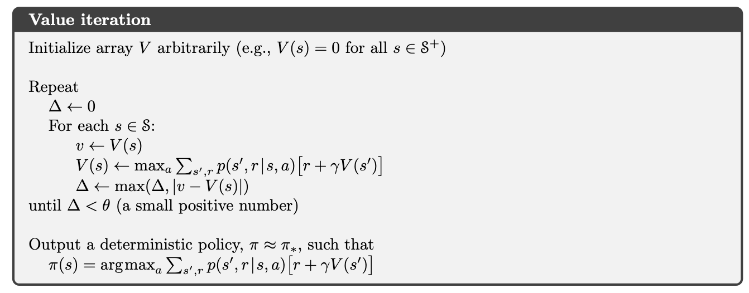

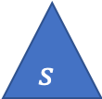


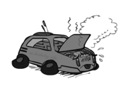
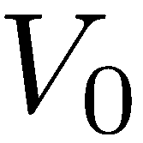


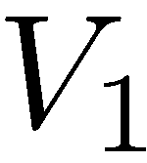



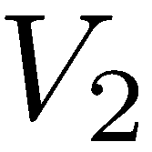
Dynamic Programming – Value Iteration
ɵ = 0.01
Cool
Go Slow Go Fast
0 0 0 ……..
Cool cool warm
+1 +2 +2
1.0 0.5 0.5
Synchronous Updates
Faculty Development Workshop on Deep Reinforcement Learning - 9 & 10 March,2026

Slide 19
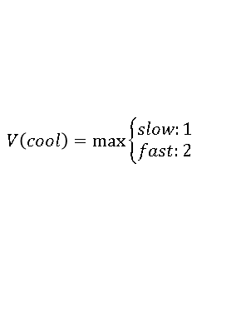
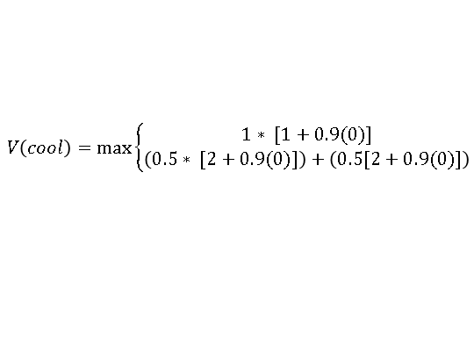
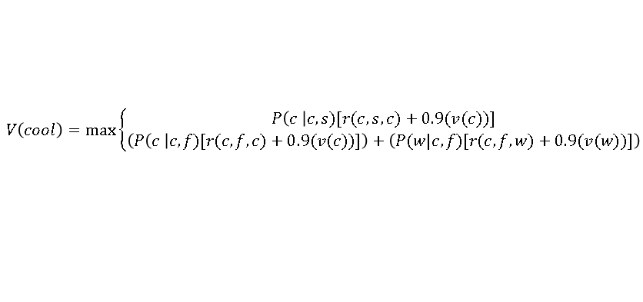
Dynamic Programming – Value Iteration
ɵ = 0.01
Cool
Go Slow Go Fast
0 0 0 ……..
2 1 0……….
Cool cool warm
Below is done only for state : “Cool”. Repeat this for all the states “Warm”, “Overheated” per iteration
+1 +2 +2
1.0 0.5 0.5
Synchronous Updates
Faculty Development Workshop on Deep Reinforcement Learning - 9 & 10 March,2026

Slide 20
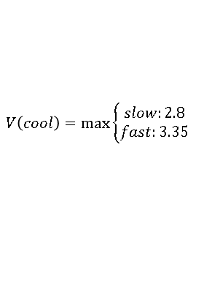
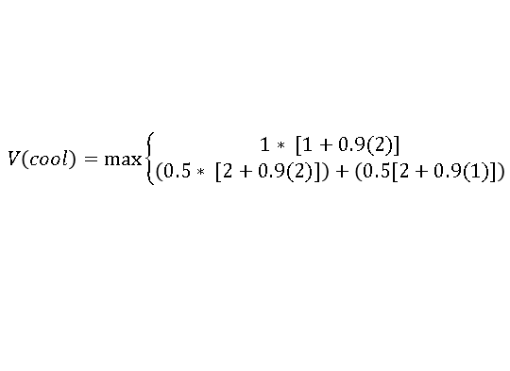
Dynamic Programming – Value Iteration
ɵ = 0.01
Cool
Go Slow Go Fast
0 0 0 ……..
2 1 0……….
Cool cool warm
3.35 2.35 0 ………
Below is done only for state : “Cool”. Repeat this for all the states “Warm”, “Overheated” per iteration
+1 +2 +2
1.0 0.5 0.5
Synchronous Updates
Faculty Development Workshop on Deep Reinforcement Learning - 9 & 10 March,2026

Slide 21
Dynamic Programming – Value Iteration
ɵ = 0.01
Cool
Go Slow Go Fast
0 0 0 ……..
2 1 0……….
Cool cool warm
3.35 2.35 0 ………
…….
+1 +2 +2
1.0 0.5 0.5
V₄₉
~15.41 ~14.41 0
∆ = ~0.009 less than threshold ɵ = 0.01
Algorithm converges slowly. Without ɵ converges ~208th
Can faster convergence possible ? Yes via Asynchronous Value Updates. Idea is to use the recent values V(S`) even within the same iteration ! One iteration is shown in next slide
Synchronous Updates
Faculty Development Workshop on Deep Reinforcement Learning - 9 & 10 March,2026

Slide 22
Dynamic Programming – Value Iteration
ɵ = 0.01
Cool
Go Slow Go Fast
0 0 0 ……..
2
Cool cool warm
Below is done only for state : “Cool”. In this same iteration while updating the V(Warm) use recent value of V(Cool) = 2 not 0 .
+1 +2 +2
1.0 0.5 0.5
Asynchronous Updates
Faculty Development Workshop on Deep Reinforcement Learning - 9 & 10 March,2026

Slide 23
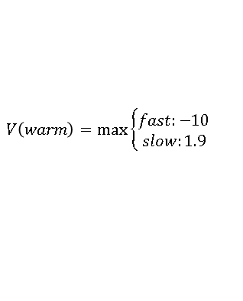
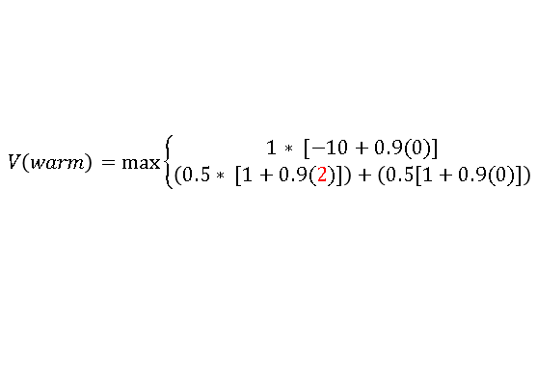
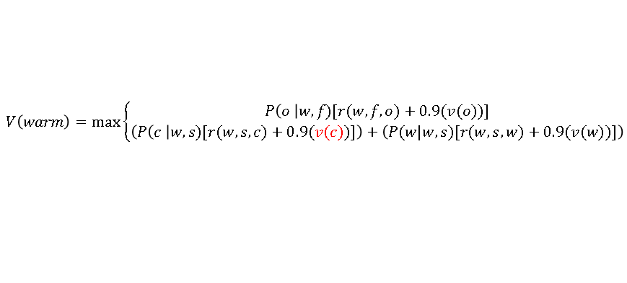
Dynamic Programming – Value Iteration
ɵ = 0.01
Cool
Go Slow Go Fast
0 0 0 ……..
2 1.9 0
Cool cool warm
Below is done only for state : “Cool”. In this same iteration while updating the V(Warm) use recent value of V(Cool) = 2 .
+1 +2 +2
1.0 0.5 0.5
Asynchronous Updates
Faculty Development Workshop on Deep Reinforcement Learning - 9 & 10 March,2026

Slide 24
Dynamic Programming – Value Iteration
ɵ = 0.01
Cool
Go Slow Go Fast
0 0 0 ……..
2 1.9 0……….
Cool cool warm
3.75 3.54 0 ………
…….
+1 +2 +2
1.0 0.5 0.5
V₄₀
~15.44 ~14.44 0
∆ = ~0.008 less than threshold ɵ = 0.01
Algorithm converges fast. Without ɵ converges at ~157th iteration!
Asynchronous Updates
Faculty Development Workshop on Deep Reinforcement Learning - 9 & 10 March,2026

Slide 25
Dynamic Programming – Value Iteration
ɵ = 0.01
Cool
Go Slow Go Fast
0 0 0 ……..
2 1.9 0……….
Cool cool warm
3.75 3.54 0 ………
…….
+1 +2 +2
1.0 0.5 0.5
V₄₀
~15.44 ~14.44 0
After convergence extract the policy by choosing the action that lead to the converged maximum value here from V40th iteration
State | Best Action
Cool | Fast
Warm | Slow
Overheated | -
Asynchronous Updates
Faculty Development Workshop on Deep Reinforcement Learning - 9 & 10 March,2026

Slide 26

Dynamic Programming Solution
Policy Iteration Algorithm
In many cases, sometimes policies is observed to converge faster than value!
So why wait for entire value updates?
Faculty Development Workshop on Deep Reinforcement Learning - 9 & 10 March,2026

Slide 27
Dynamic Programming
1
Given
P(s` | s, a) , R(s, a, s`) , P(s`, r | s, a)
2
To find
Policy π
3
Solution
Policy Iteration (PI): Prefer this in a relatively smaller state space where intermediate termination provides explicit interpretable policy
Value Iteration (VI): Prefer this in a relatively larger state space where fast convergence to optimal policy is obtained at the end
VI can be thought of truncated PI where evaluation is done fully before improvement.
4
Idea
PI : One Step Look ahead 🡪 Evaluate 🡪 Improve
VI : One Step Look ahead 🡪 Control
🡨 Number of state sweeps (updates) can be controlled if required (similar to mini-batch /stochastic processing). Evaluate & Improve steps are alternatively are done .
Faculty Development Workshop on Deep Reinforcement Learning - 9 & 10 March,2026

Slide 28
Policy Evaluation (Prediction)
Goal
Key Properties
Given policy π, compute Vᵄ(s) for all s ∈ S.
Produces the state-value function consistent with π.
Convergence guaranteed by Bellman contraction mapping.
Synchronous DP: all states updated each sweep.
Convergence: Vₖ → Vᵄ as k → ∞ (geometric rate).
Stop when maxₛ |Vₖ₊₁(s) − Vₖ(s)| < θ (small threshold).
Iterative Policy Evaluation Algorithm
Initialise V(s) = 0 for all s ∈ S ; V(terminal) = 0
Repeat:
δ ← 0
For each s ∈ S:
v ← V(s)
V(s) ← Σₐ π(a|s) Σₛ’,ᵣ p(s’,r|s,a) [ r + γ V(s’) ]
δ ← max(δ , |v − V(s)|)
Until δ < θ

Slide 29
Policy Improvement
Policy Improvement Theorem
If Qᵄ(s, π’(s)) ≥ Vᵄ(s) for all s, then Vπ’(s) ≥ Vᵄ(s) for all s.
Greedy Policy Improvement
Policy Iteration Algorithm
π’(s) = argmaxₐ Qᵄ(s,a)
= argmaxₐ Σₛ’,ᵣ p(s’,r|s,a)[r + γ Vᵄ(s’)]
If π’ = π after improvement:
⇒ Bellman optimality holds for all s
⇒ Vᵄ = V* and π is already OPTIMAL
1. Initialise π arbitrarily for all s ∈ S.
2. Policy Evaluation: compute Vᵄ until convergence.
3. Policy Improvement: π’(s) = argmaxₐ Qᵄ(s,a).
4. If π’ ≠ π: set π ← π’, goto Step 2.
5. Else: STOP — π is optimal.
Converges in finite steps for finite MDPs.

Slide 30
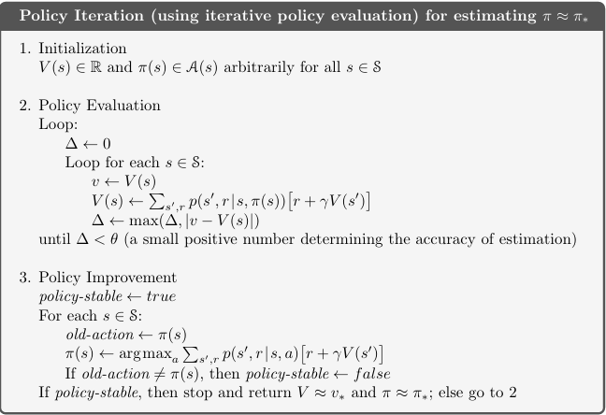
Dynamic Programming – Policy Iteration
ɵ = 0.01
Cool
Go Slow Go Fast
0 0 0 ……..
Cool cool warm
+1 +2 +2
1.0 0.5 0.5
We will use asynchronous for updates in this example. Note that even though above backup diagram depicts all possible transition, this algorithm computes value from only one of the action as given by the initialized policy at the start of every iteration!!!
π₀
State | Best Action
Cool | Slow
Warm | Slow
Overheated | -
Faculty Development Workshop on Deep Reinforcement Learning - 9 & 10 March,2026

Slide 31
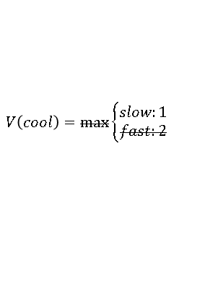
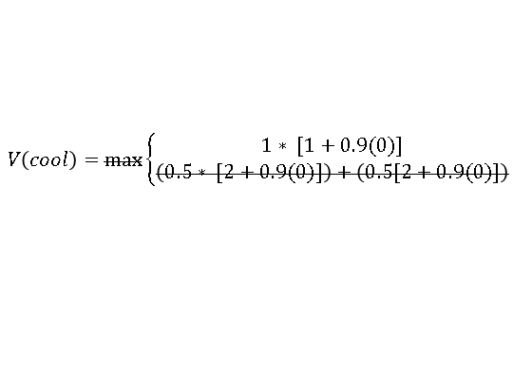
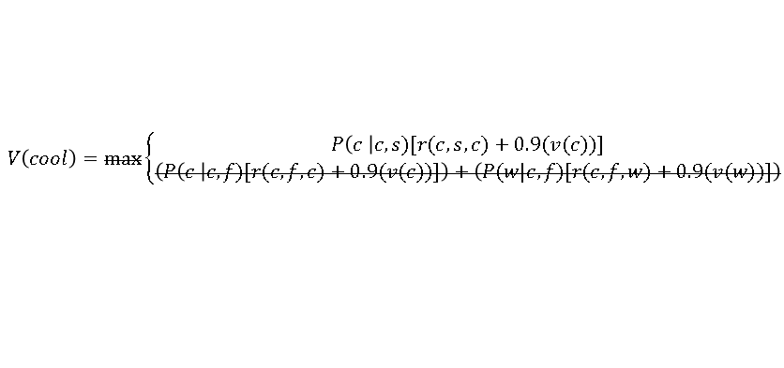
Dynamic Programming – Policy Iteration
Policy Evaluation Starts
ɵ = 0.01
Cool
Go Slow Go Fast
0 0 0 ……..
1 1.45 0……….
Cool cool warm
This slide show what change from Value iteration to Policy iteration algorithm in the Evaluation step!. Since only action needs to be assessed, MAX of all actions outcome is no longer required in this PE cycle!
The value uses the initialized policy to select only one action GREEDILY. Hence below cancelled equations differentiated PI vs VI
+1 +2 +2
1.0 0.5 0.5
Faculty Development Workshop on Deep Reinforcement Learning - 9 & 10 March,2026

Slide 32
Dynamic Programming – Policy Iteration
Policy Evaluation Completes
ɵ = 0.01
Cool
Go Slow Go Fast
0 0 0 ……..
1 1.45 0……….
Cool cool warm
1.9 2.51 0……….
+1 +2 +2
V₂₂₅
~10 ~ 10 0
1.0 0.5 0.5
In PE, either synchronous or asynchronous value updates can be followed
If Threshold of 0.01 is applied then approx., at 46th iteration algorithm converges
Assume that Asynchronous method is used & Thresholding is not applied. In this case at approx., near 225th iteration values converge
Faculty Development Workshop on Deep Reinforcement Learning - 9 & 10 March,2026

Slide 33
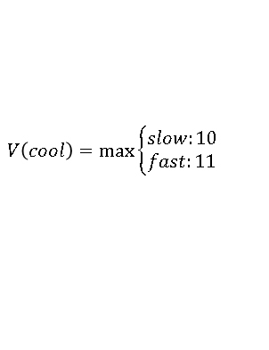
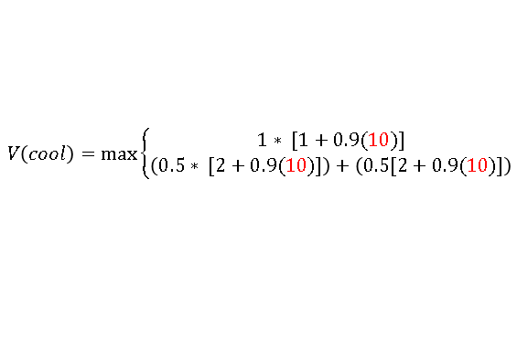
Dynamic Programming – Policy Iteration
Policy Improvement
ɵ = 0.01
Cool
Go Slow Go Fast
0 0 0 ……..
1 1.45 0……….
Cool cool warm
1.9 2.51 0……….
After PE is done, PI starts where the last value from PE is used to find the next best action. In this PI phase all actions are analysed and best action that MAXimises the value is chosen to update the policy
~10 ~ 10 0
+1 +2 +2
V₂₂₅
1.0 0.5 0.5
Faculty Development Workshop on Deep Reinforcement Learning - 9 & 10 March,2026

Slide 34
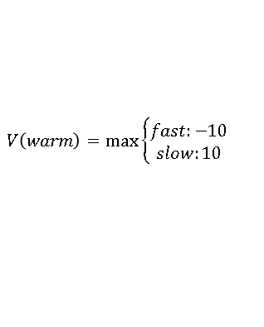
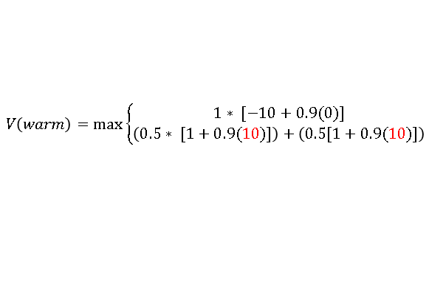
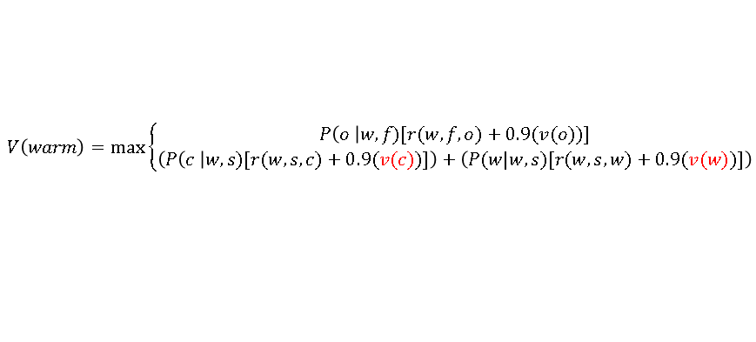
Dynamic Programming – Policy Iteration
Policy Improvement
ɵ = 0.01
Cool
Go Slow Go Fast
0 0 0 ……..
1 1.45 0……….
Cool cool warm
1.9 2.51 0……….
After PE is done, PI starts where the last value from PE is used to find the next best action. In this PI phase all actions are analysed and best action that MAXimises the value is chosen to update the policy
~10 ~ 10 0
+1 +2 +2
V₂₂₅
1.0 0.5 0.5
Faculty Development Workshop on Deep Reinforcement Learning - 9 & 10 March,2026

Slide 35
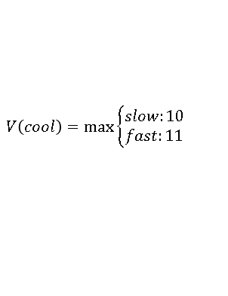
Dynamic Programming – Policy Iteration
Policy Improvement Completes
ɵ = 0.01
Cool
Go Slow Go Fast
0 0 0 ……..
1 1.45 0……….
Cool cool warm
1.9 2.51 0……….
~10 ~ 10 0
+1 +2 +2
V₂₂₅
1.0 0.5 0.5
π₁
State | Best Action
Cool | Fast
Warm | Slow
Overheated | -
Faculty Development Workshop on Deep Reinforcement Learning - 9 & 10 March,2026

Slide 36
Dynamic Programming – Policy Iteration
Continue another cycle of PE🡪PI
ɵ = 0.01
Cool
Go Slow Go Fast
10 10 0 ……..
Cool cool warm
+1 +2 +2
1.0 0.5 0.5
π₁
State | Best Action
Cool | Fast
Warm | Slow
Overheated | -
After this cycle of algorithm converges with values :
V(cool) = 15.5
V(Warm) = 14.5
Faculty Development Workshop on Deep Reinforcement Learning - 9 & 10 March,2026

Slide 37
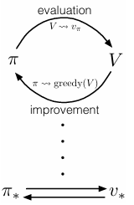
Dynamic Programming - Policy Iteration
1
Observation
Policy iteration consists of two simultaneous, interacting processes, one making the value function consistent with the current policy (policy evaluation), and the other making the policy greedy with respect to the current value function (policy improvement).
In policy iteration, these two processes alternate, each completing before the other begins, but this is not really necessary.
Generalized policy iteration (GPI) to refer to the general idea of letting policy-evaluation and policy improvement processes interact, independent of the granularity and other details of the two processes. Almost all reinforcement learning methods are well described as GPI.
In one cycle perform only one iteration of Policy Evaluation (ie.,Value Updates) without waiting for convergence immediately follow by Policy Improvement.
Solution : GPI Generalized Policy Iteration
Idea (Do this as an exercise for given problem)
Faculty Development Workshop on Deep Reinforcement Learning - 9 & 10 March,2026

Slide 38
Generalised Policy Iteration (GPI)
GPI: Generalised Policy Iteration — the general schema of interleaving policy evaluation and improvement. Almost all RL methods can be described as GPI.
Evaluation Process
Improvement Process
Spectrum of GPI
Makes V consistent with the CURRENT policy π.
Applies Bellman expectation backups.
Drives V toward Vπ.
Does NOT need to converge fully before improvement begins.
Makes π greedy w.r.t. current V.
Changes the policy, which invalidates V again.
The two processes COMPETE — but together converge.
Fixed point = optimal (π*, V*) for both processes.
Policy Iter: full eval → improve.
Value Iter: 1 sweep → improve.
Async DP: update any states freely.
TD / Q-learning: model-free GPI.
Actor-Critic: parallel eval + improve.
Deep RL: approximate GPI with NNs.

Slide 39
GPI — Convergence and Geometric View
Convergence of GPI
Geometric View
Evaluation: drives Vπ closer to V (policy-consistent manifold).
Improvement: ensures π greedy w.r.t. V (value-consistent manifold).
Fixed point: neither process changes anything ⇒ π = π* and V = V*.
Two manifolds in (V, π) space:
Policy-consistent manifold: V = Vπ
Value-consistent manifold: π greedy w.r.t. V
Eval & improve zigzag toward their intersection = (V*, π*).
Practical Takeaways
1
GPI unifies all DP methods and provides the theoretical bridge to model-free RL (TD, Q-learning, Actor-Critic, Deep RL).
2
Truncated or approximate policy evaluation still yields policy improvement — full convergence is NOT required.
3
Key to scalable RL: partial/approximate GPI with function approximation (neural networks in Deep RL).
Reference: Sutton & Barto, Reinforcement Learning: An Introduction, 2nd Ed., Ch. 3 & 4 | freely available at incompleteideas.net

Slide 40
PI vs VI — Through the GPI Lens
Aspect | Policy Iteration (PI) | Value Iteration (VI) | GPI (General)
Evaluation depth | Full convergence (Δ < θ) | Single Bellman sweep | Any depth k ≥ 1
Bellman update | Σₐ π(a|s) · … (expectation) | max_a (…) at each step | Mixed or alternating
Policy update | After full evaluation | Implicitly each sweep | After k eval steps
Policy visible? | Yes — explicit at each step | Only at end | Depends on method
Convergence speed | Fewer outer iterations | More outer iterations | Adjustable tradeoff
Compute/iteration | More (full eval phase) | Less (one sweep) | Configurable
Best for | Small state spaces | Large state spaces | General / practical RL
Race Car | Optimal in 3 PI steps | Optimal in 23 VI steps | Both are GPI instances

Slide 41
Summary & Bridge to Model-Free RL
Topic
Key Idea
1
MDP = { S, A, P, R, γ }
Formal framework for sequential decisions under uncertainty
2
Value Functions
Vπ(s) and Qπ(s,a) quantify long-term goodness
3
Bellman Equation
Recursive decomposition that makes computation tractable
4
Dynamic Programming
Solve Bellman equations when the model is KNOWN
5
GPI Framework
Eval ↔ Improve alternation — unifies ALL DP methods
Next: What if we DON’T know the model?
Monte Carlo
TD Learning
Q-Learning
Learn V from complete episode returns
Learn V from one-step bootstrapped estimates
Learn Q* directly off-policy (model-free!)
GPI still applies in model-free RL — but Evaluation uses sampled experience instead of known dynamics!

Slide 42
Thank you

